Slide 1












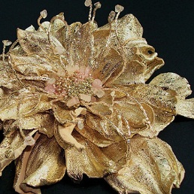


Виды товара
основной тезис ваших товаров (его прочтут)
Броши
Галстуки
Ежедневники
Описание продаваемого товара.
Описание продаваемого товара.
Описание продаваемого товара.
The universe is commonly defined as the totality of everything that exists including all physical matter and energy, the planets, stars, galaxies, and the contents of intergalactic space
The universe is commonly defined as the totality of
The universe is commonly defined as the totality of everything that exists including all physical matter and energy, the planets, stars, galaxies, and the contents of intergalactic space
The universe is commonly defined as the totality of
The universe is commonly defined as the totality of everything that exists including all physical matter and energy, the planets, stars, galaxies, and the contents of intergalactic space
The universe is commonly defined as the totality of
тел.:
e-mail:
сайт:
(495) 226-74-30
art@prcomm.ru
www.kit5.ru

